Slide 1
The Nature of conflict

Slide 2
Questions we ask ourselves
Where do we see conflict most often?
What do you do when you encounter conflict?
Who are you most likely to have conflict with?
  How often are you around them?
  Do you find the conflict beneficial or is it harmful in the end?

Slide 3
Family Relationships
People you are tightly coupled with and spend ample time with in close quarters?
  Where does this happen?
The way we handle conflict is largely impacted by familial patterns
High levels of destructive marital conflict leads to increased loneliness and causes high levels of anxiety and distress in children
  High conflict families cause more mental instability than divorced families in adolescents
  Conflict resolution and relationship dissolution are handled very differently depending on conflict styles within the household

Slide 4


Love Relationships
First Big Fight
  https://www.youtube.com/watch?v=P7TgJNpq40g
  https://www.youtube.com/watch?v=JKKyxmf_BR8
  https://www.youtube.com/watch?v=_hFMsMa9Amw
Shared beliefs about conflict and problem solving methods
  How do we talk through differences with someone we care about?
  What are certain ways to calm tense situations?
  What can you not handle during an argument?

Slide 5
The Workplace
We carry our personal lives and identities into the workplace
Conflict in the workplace creates fear, doubt and inefficiency
Goal oriented conflict- making sure you are arguing for the same purpose
Managers and co-workers should take time to get to know one another and how to effectively communicate with one another
Understanding process and recognition needs of each individual
Dispute resolution techniques need to be taught to managers and team leaders
Conflict cannot simply be ignored
Mismanagement of conflict will result in failure and/or group dissolution
Knowing the goals of your company
Creating group goals and projects
Voicing your individual goals to members of management

Slide 6
The Importance of skill development
Unresolved Conflict- affects conflicting parties, heightens uncertainty and apprehension, and causes relational rifts and distance
Benefits of learned skills:
  Emotional Intelligence- capacity for recognizing our own feelings and those of others
  Mental health and stability
  Long-term self and relational satisfaction
  Positively impacting those around you
  Managing emotions well in ourselves
  Avoiding the urge to force your opinions and feelings on others, or completely withdrawing from conflict situations

Slide 7

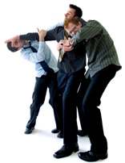
Preventing Destructive Conflict
Anticipating
Mitigating
Depriving the conflict of power
Reducing vulnerability
Taking advanced measures
Addressing the causes
Finding common ground
Dissolving destructive relationships

Slide 8
What Leads to Destruction?
CRITICIZING
DEFENSIVENESS
STONEWALLING
CONTEMPT
Which are you most guilty of?
- Over-stating; Exaggerating; Hyperbole
- Sense of righteous indignation; responding without listening
- Withdrawal; Avoidance; Refusal; Attempting to control the communication patterns and manipulate other people’s behavior
- Sarcasm, ridicule, hostility and embarrassment are all signs of contempt. These actions require intervention or relationship dissolve

Slide 9
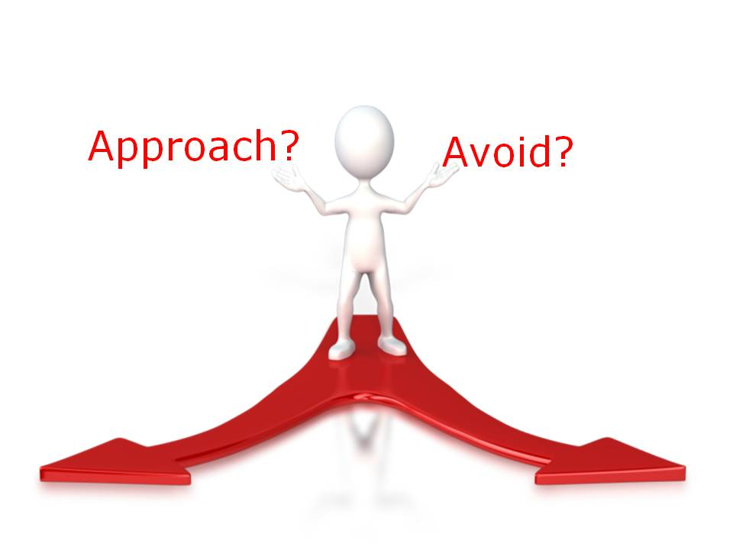
What is the avoidance spiral?

